Slide 2

HEROES4REGIONS
Joint Practice-Oriented Scientific Research Hub
1st Call for small-scale cooperation projects

Slide 3

Objective
Bottom-up cross-institutional cooperation
Practice-oriented research, innovation, knowledge transfer and research valorisation
Local and regional stakeholder involvement
Seed funding for future expansion
European collaboration ambition
!! Activate collaboration, not fund research per se
Mascot by Anastasija Kotelnikova

Slide 4
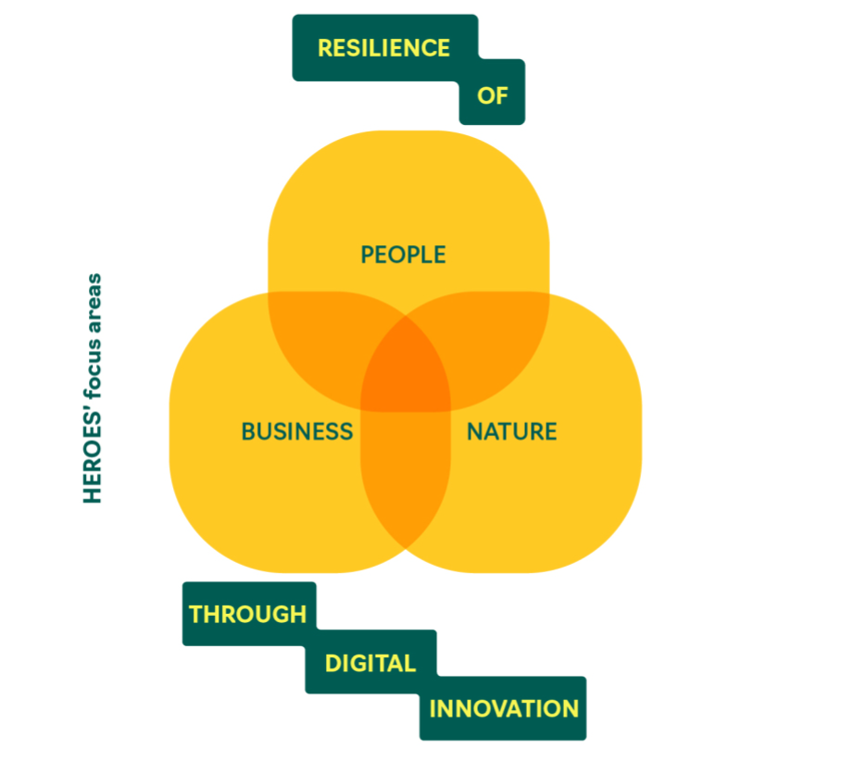
Objective
Capacity-building
Joint analyses
Methodology training
Hackathons / workshops
Co-creation labs
Toolbox development
❌research execution
❌data collection
❌scientific conferences
❌scientific publications
❌proposal writing
Any innovative or creative activity that strengthens interinstitutional collaboration in research, innovation, knowledge transfer, and valorisation.

Slide 5

Funding framework
Budget overview
  € 243,000
  € 81,000 per call
  9 small-scale projects per call
  Max. €9,000 per project
Cost model
  Apply Implement Report Lump sum
  Lump sum model
  Allocated to the main applicant
  Purchase costs
  Co-funding required (staff time)
  Focus on results
Mascot by Anastasija Kotelnikova

Slide 6
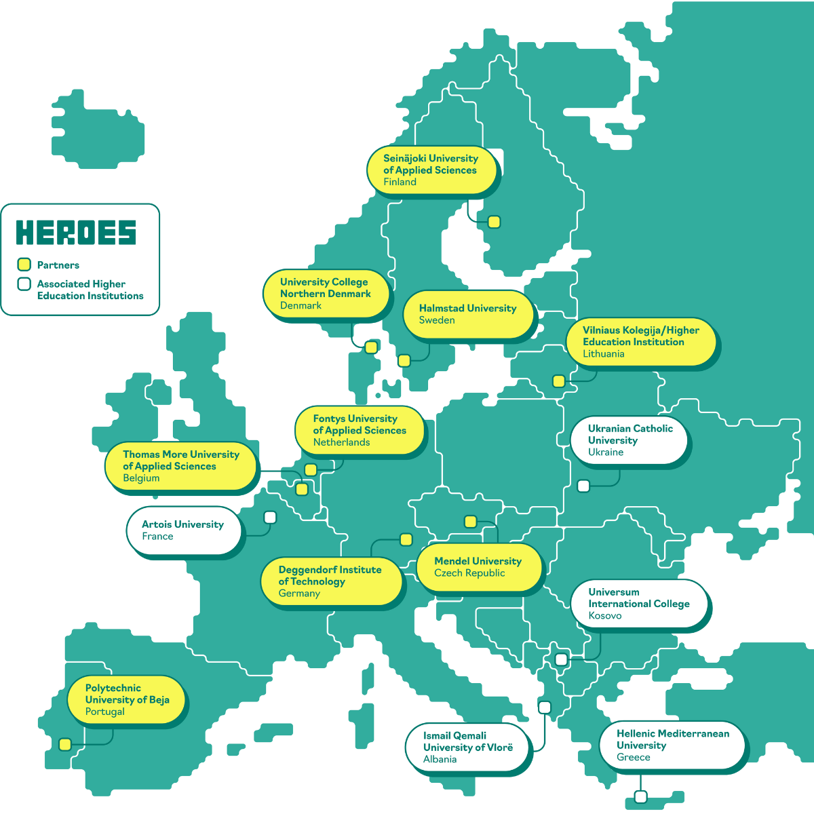
Eligibility requirements
Minimum 3 HEROES institutions (Beneficiaries)
Active staff involvement
Clear Smart Regional Resilience alignment
Stakeholder engagement
Meaningful institutional contribution
See: appendix F
Stakeholders such as students, citizens, SMEs, Public authorities, NGOs, “HEROES Friends” (see appendix F)

Slide 7
Examples
Joint co-creation workshop series with local stakeholders around a specific challenge to strengthen people’s and nature’s resilience.
Capacity-building for research support staff
Research support teams exchange practices and align procedures for knowledge transfer and valorisation.
A transnational learning network around the use of AI for a regional challenge. Researchers exchange experiences through peer-learning sessions and workshops.
Outcomes can be: roadmaps for future projects, practical toolboxes for learning, strengthened network, shared guidelines, …

Slide 8
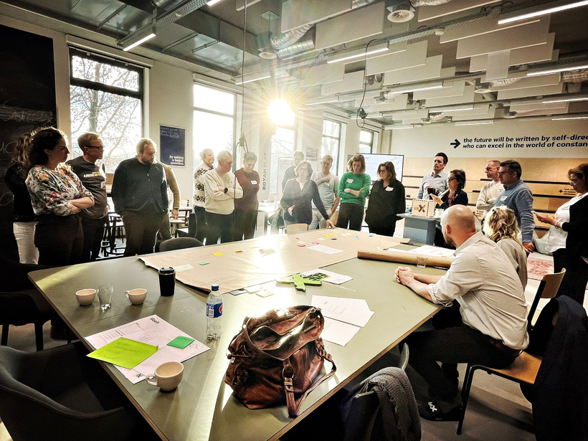
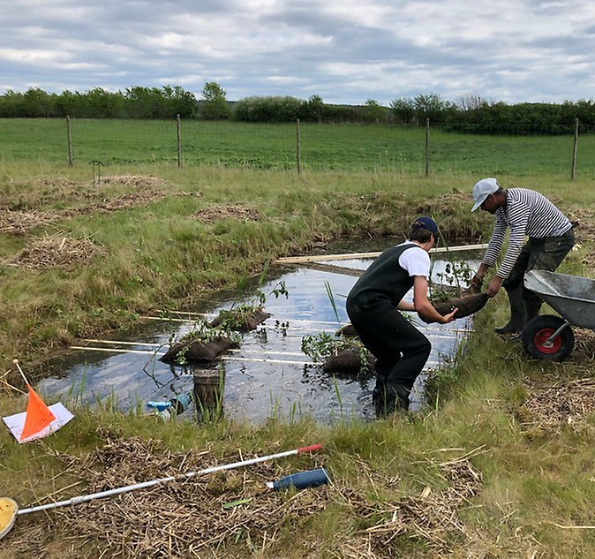
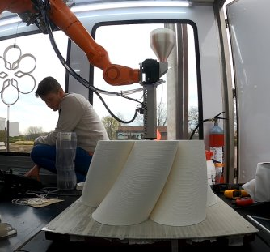
Timeline (2026)
March 2026: Opening of the call
30 April 2026: 15 May 2026: Extended deadline
16 May – 21 May 2026: Selection and evaluation
June 2026: Communication of results
From 1 September 2026: Start of the collaboration
End report call 1: at the latest by 30 June 2027.
Funded projects must be completed within a maximum of 9 months after the start date.

Slide 9

Submission procedure
Application (max. 3 pages):
  Title
  Lead applicant
  Partners (min. 3)
  Alignment statement
  Objectives
  Stakeholders
  Activities & timeline
  Impact & expansion
  Budget
Submit by email to the institutional coordinator
Mascot by Anastasija Kotelnikova

Slide 10
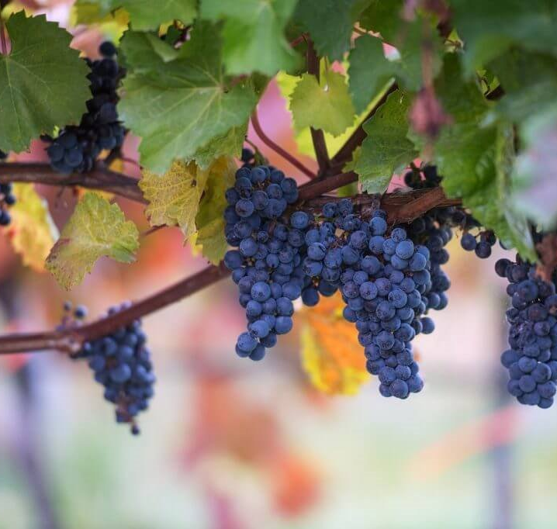
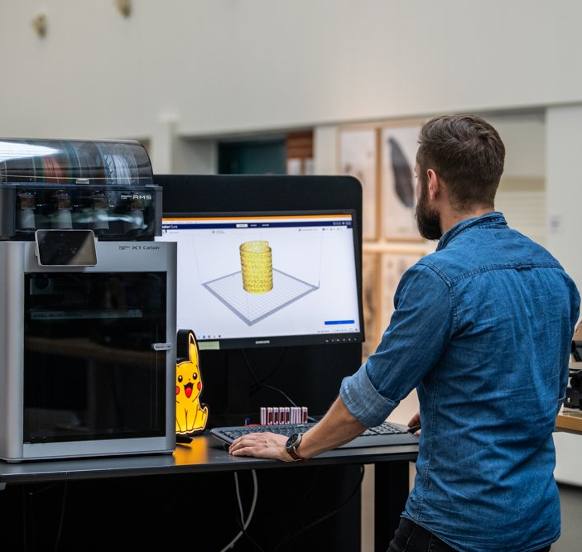
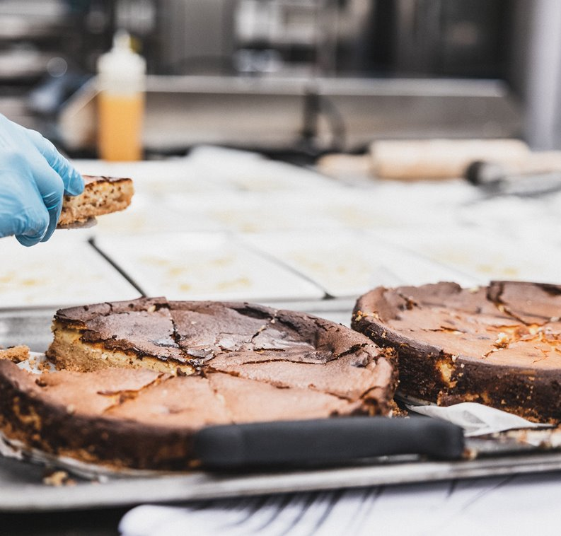
Evaluation & selection
Two-step process:
  Institutional pre-selection
  Alliance-level evaluation
Criteria
  Alignment
  Innovation
  Impact
  Stakeholders
  Expansion potential
  Feasibility & value for money
9 projects selected

Slide 11
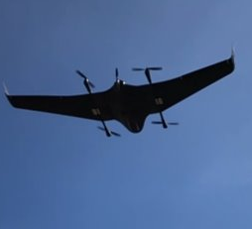
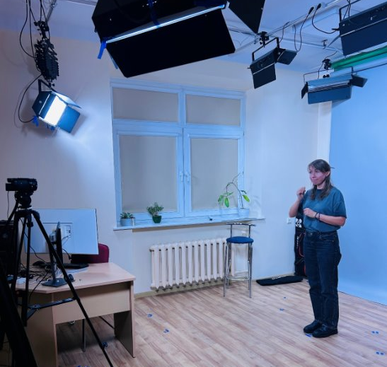
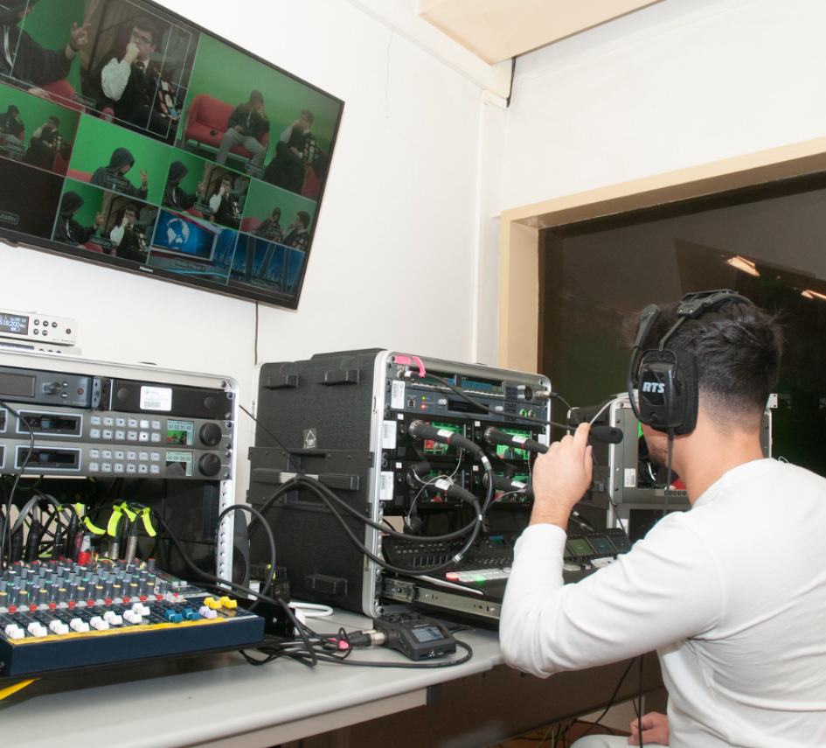
Reporting
Brief final report
Summary of activities
Reflection on impact
Evidence (photos, lists, materials)
No financial reporting
Contribution to the HEROES Science Magazine
Notes:
The lump sum is transferred only after approval of the final report.

Slide 12
References
Manual
FAQ list
Application Form template
More information:
Institution | Name | e-mail
FON | Bas Ouwehand | b.ouwehand@fontys.nl
HH | Magnus Jonsson | magnus.jonsson@hh.se
IPB | José Jasnau Caeiro | j.caeiro@ipbeja.pt
MEN | Petra Coufalová | petra.coufalova@mendelu.cz
SeAMK | Anne-Maria Mäkelä | anne-maria.makela@seamk.fi
THD | Christian Schopf | christian.schopf@th-deg.de
TM | Kris Vancluysen | kris.vancluysen@thomasmore.be
UCN | Susanne Dau | sud@ucn.dk
VIKO | Alina Katunian | a.katunian@viko.lt

Slide 14


















Powered by
In association with
Supported by

